Slide 1
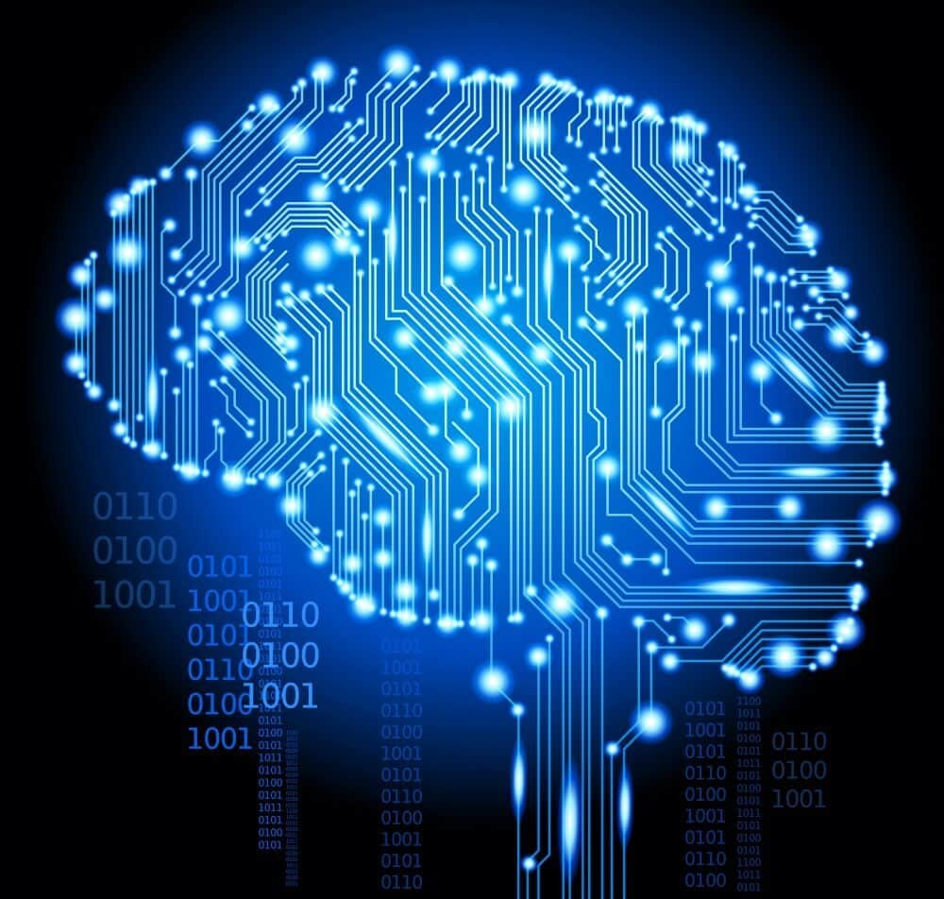

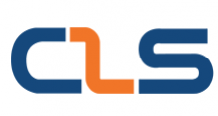
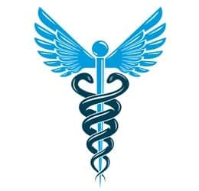

Medical Assistant
Graduation Project
Microsoft Machine Learning Engineer - CLS CAI1_AIS5_S1e

Slide 2

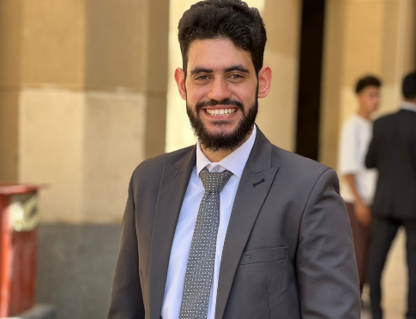
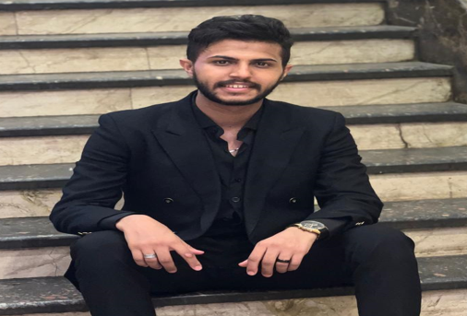

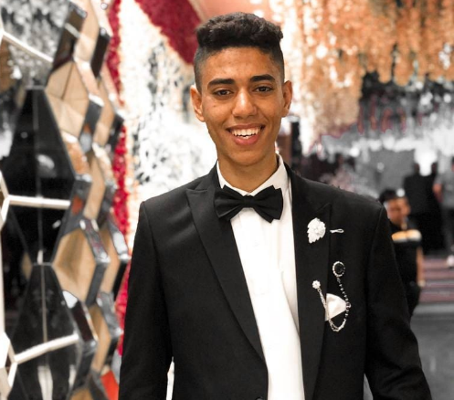
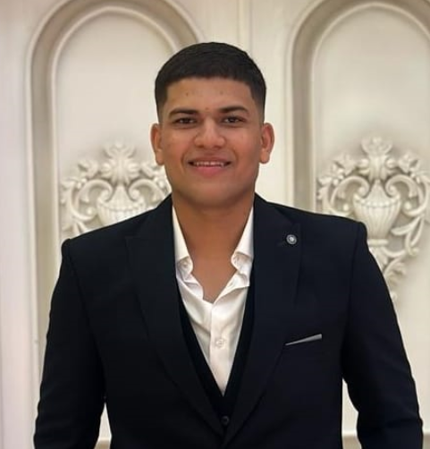

Our Team Members
Kareem Wael Elhamy Hussain
Team Leader
Ali Nasser Salah Elden Mohammed
Supervised By
Eng. Omar Shaheen
Youssef Abdalghany Mohmed
Mohmed Saeid Mohamed
Farag salama farag
Kareem Nader Naoum Sargious
Back to Agenda

Slide 3

Introduction
Problem
Solution
Our Goal
Pipeline
Deep Learning Model
steeamlit
Backend System & Tools
Database
APIs
Web Framework
Web Application
Features
Future Work
Table of Content

Slide 4


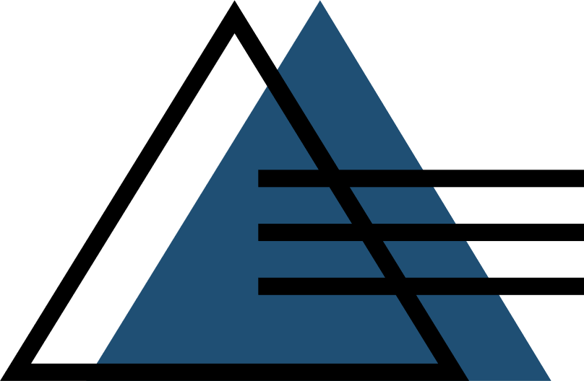
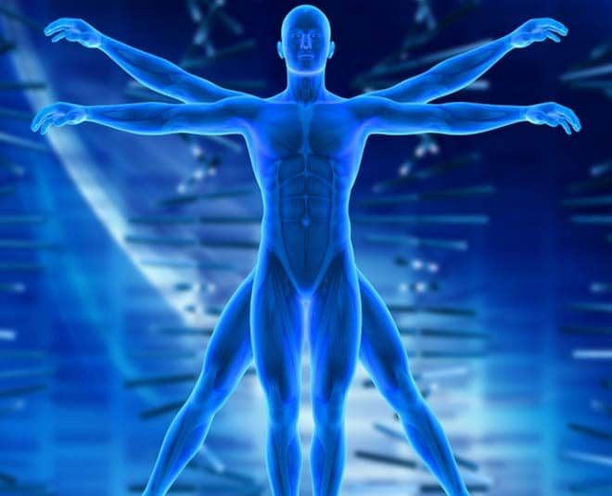
Introduction
SIGNIFICANCE
Our The human body is a complex system, and accurately diagnosing diseases can be a daunting task even for the most experienced medical professionals. Despite their expertise and dedication, doctors can sometimes make errors in their diagnoses. These errors can have serious consequences for patients, leading to delayed treatments, incorrect treatments, or even misdiagnoses.

Slide 5
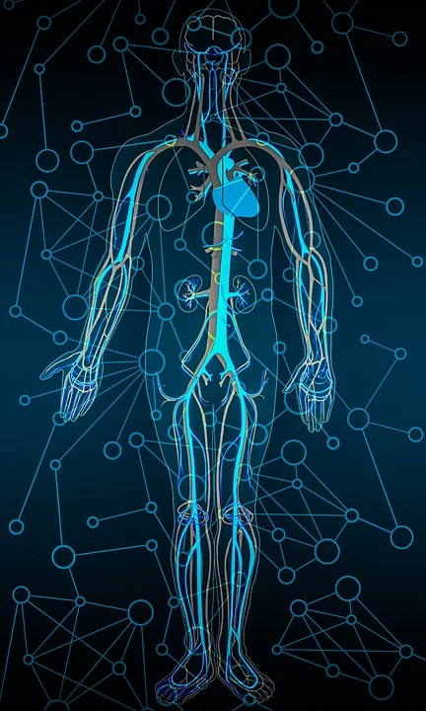
Introduction
Factors contributing to these errors include:
Cognitive Biases: Doctors, like all humans, are susceptible to cognitive biases that can influence their decision-making. These biases can lead to overlooking certain symptoms or interpreting data in a way that confirms their initial hypothesis.
Time Constraints: In busy healthcare settings, doctors may have limited time to spend with each patient. This can make it difficult to gather all the necessary information and consider all possible diagnoses.
Lack of Expertise: Some diseases are rare or complex, and doctors may not have the specialized knowledge or experience to accurately diagnose them.
Subjectivity: Medical diagnosis often involves subjective judgments, such as interpreting test results or assessing a patient's symptoms. These judgments can vary from doctor to doctor.

Slide 6
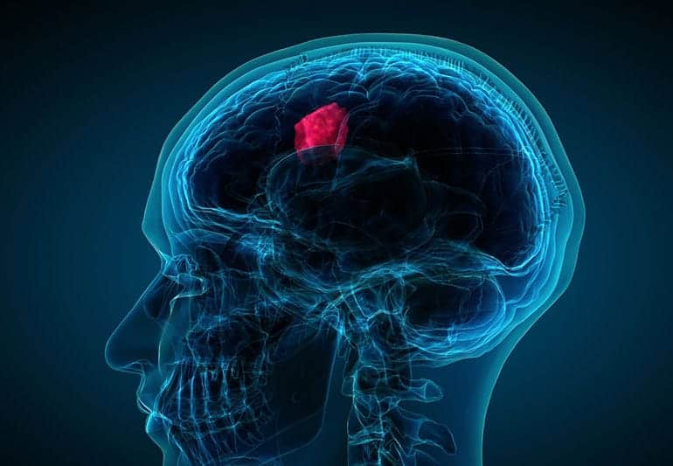
Introduction
OBJECTIVE
Our project investigates the use of deep learning technology in the medical field to help doctors and patients know if they have brain cancer &Ocular disease or not.

Slide 7


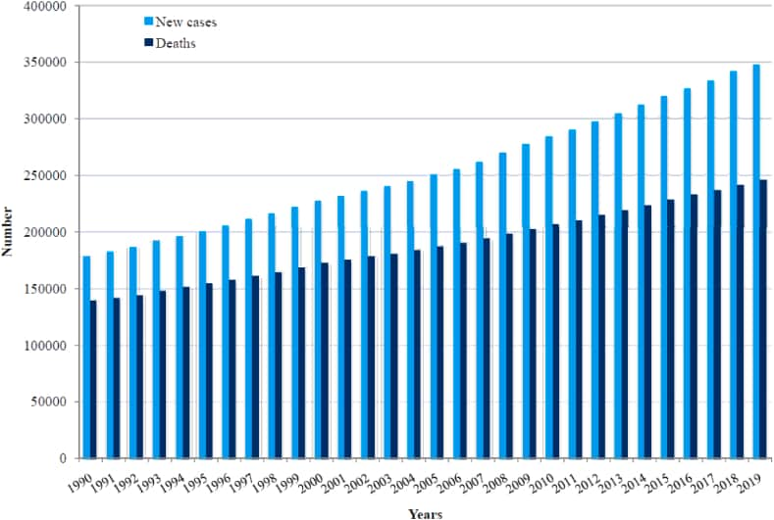
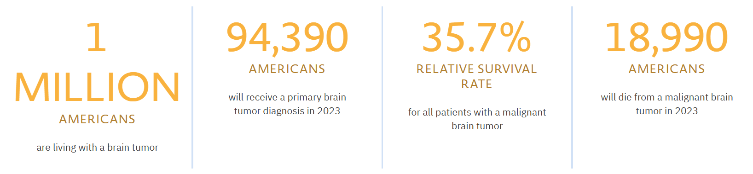
Problem1
The traditional methods of brain tumor classification based on manual inspection of MRI images are time-consuming and subject to human error.
Brain tumors pose a significant threat to human health, and early detection plays a crucial role in effective treatment. According to estimates, a considerable number of individuals are diagnosed with brain tumors annually, making it a pressing issue.
International patterns and trends in the brain cancer
Brain Tumor Facts

Slide 8
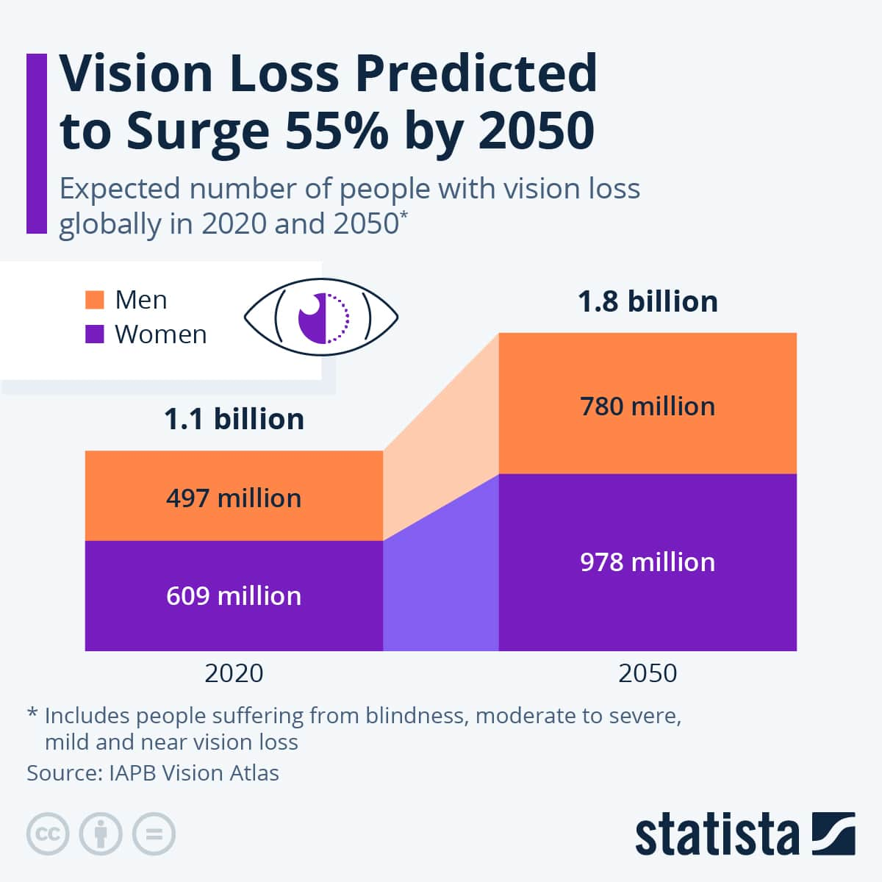
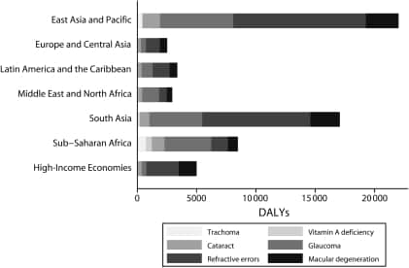
Problem2
According to the World Health Organization (WHO), there are around 2.2 billion people who are visually impaired worldwide, and at least 1 billion of these cases might have been prevented.
Ocular diseases can be very severe and lead to blindness. Therefore, early identification of the disease can lessen the severity of the condition.
Here,we have solved this problem using some Deep Learning models to predict whether an image belongs to DiabeticRetinopathy, Glaucoma, Cataracts, Agerelated Macular Degeneration, Myopia, Hypertension.

Slide 9

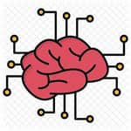
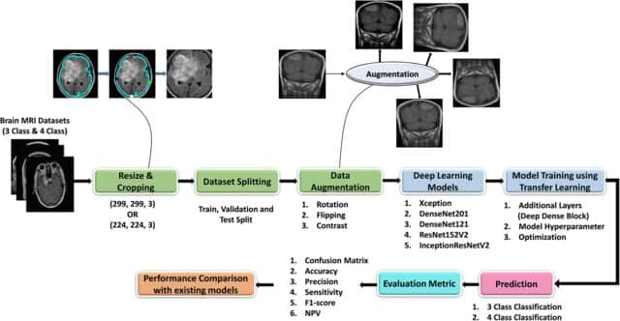


Solution
Convolutional Neural Network (CNN)
For better results than machine learning techniques, we can use deep learning techniques, especially CNN.
The specialized architecture of CNNs demonstrates superior accuracy and efficiency compared to traditional fully connected networks.
Convolutional layer allow the network to autonomously learn and extract spatial hierarchies of features.
The adaptive features determined through backpropagation, including convolution layers, pooling layers, and fully connected layers, contribute to the system's ability to discern complex patterns in images.

Slide 10
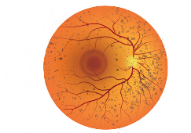
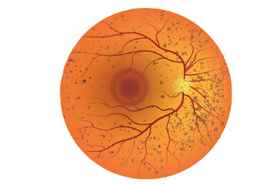
Solution
Normal vs Diabetic
Normal vs Glaucoma
Convolutional Neural Network (CNN)
Diabetic : 0.67
Glaucoma : 0.32
Cataract :0.21
AMD : 0.87 Hypertensive : 0.06
Myopia : 0.02
Other : 0.97
Upload Image
Normal vs Cataract
Aggregator
For better results than machine learning techniques, we can use deep learning techniques, especially CNN.
The specialized architecture of CNNs demonstrates superior accuracy and efficiency compared to traditional fully connected networks.
Normal vs AMD
Normal vs Hypertensive
Convolutional layer allow the network to autonomously learn and extract spatial hierarchies of features.
Normal vs Other
Normal vs Myopia
The adaptive features determined through backpropagation, including convolution layers, pooling layers, and fully connected layers, contribute to the system's ability to discern complex patterns in images.

Slide 11
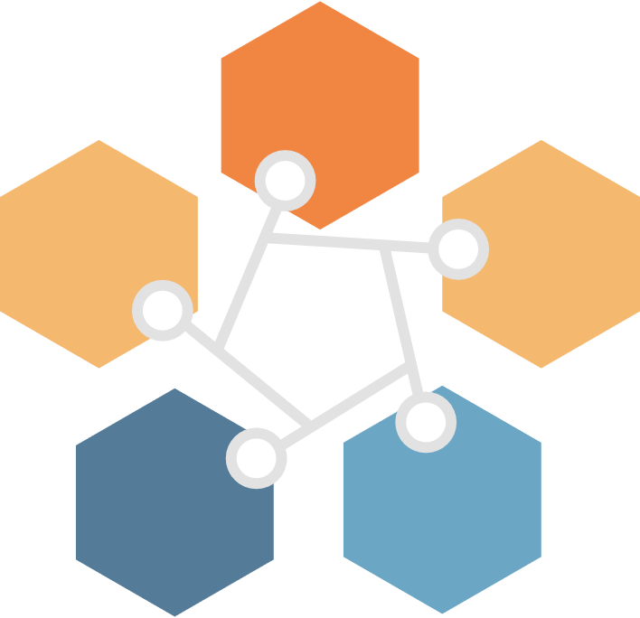
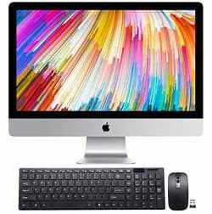
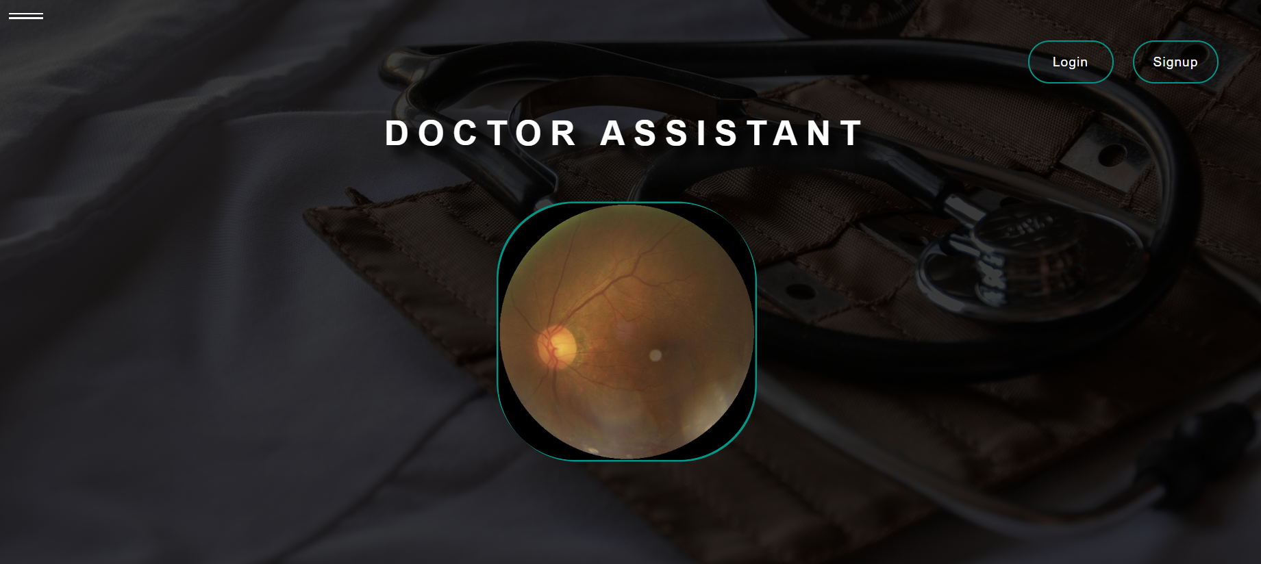
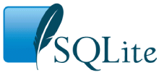

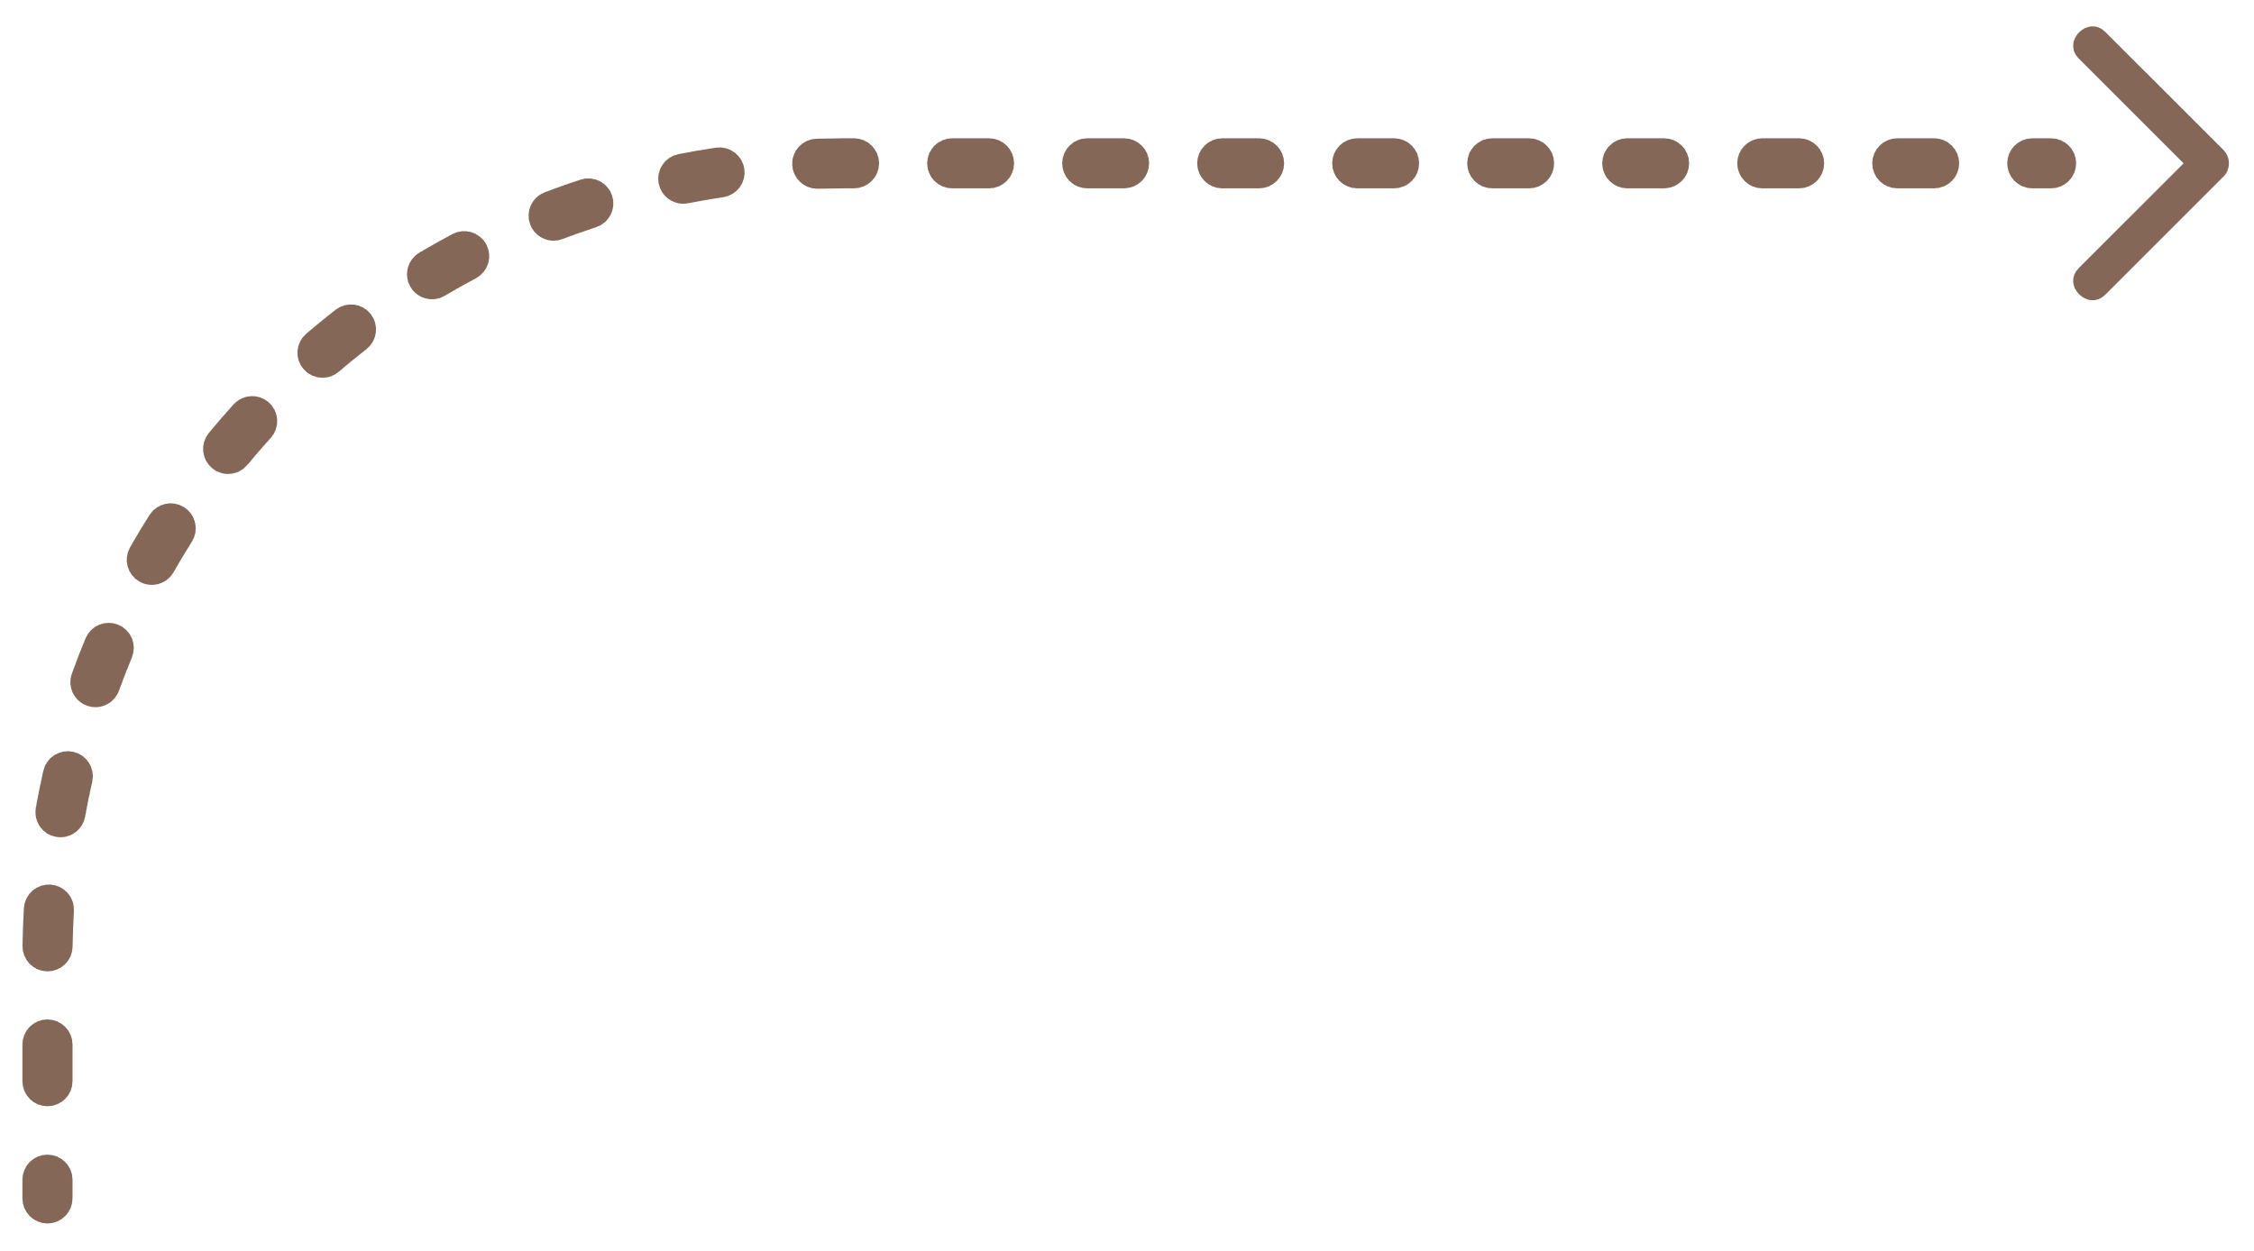


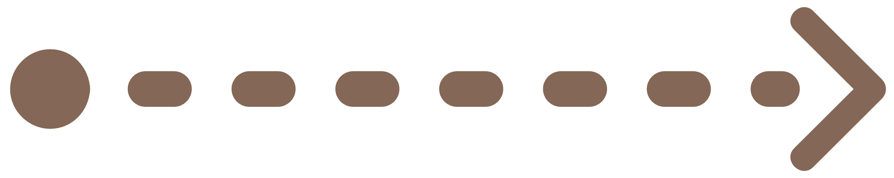



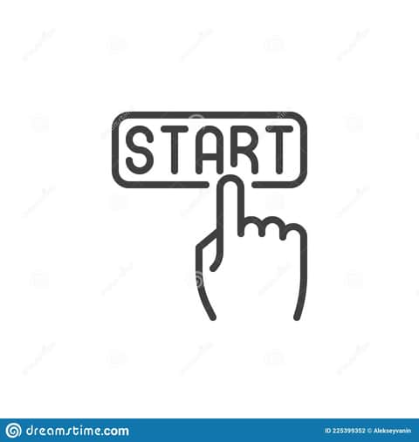

Pipeline
Deep
Learning
Model
SQLite
(Database)
Send Conclusions
Get Response
Send Request
Success
Validate
Check
Send Data
Camera Or Gallery
API Controller And Backend System
Send Image
Verify
Ai Page
input
Register
Login
APIs
(MRI) & (OCT)
Send Request
Get Response
SQLite
Admin
SDK
Doctor

Slide 12
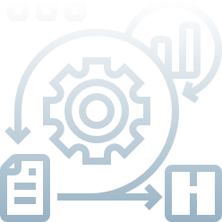

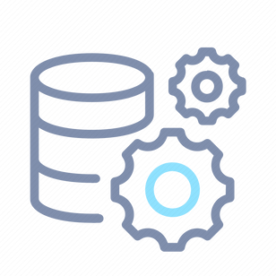

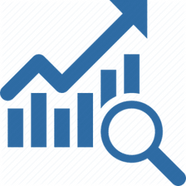

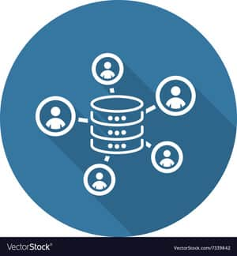
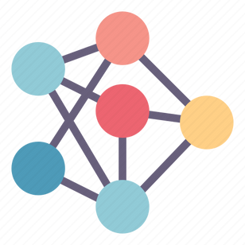



Ml Model Methodology
DL Model Methodology
Image Preprocessing
Model Selection
Data Collection
Model Training
Model Evaluation

Slide 13
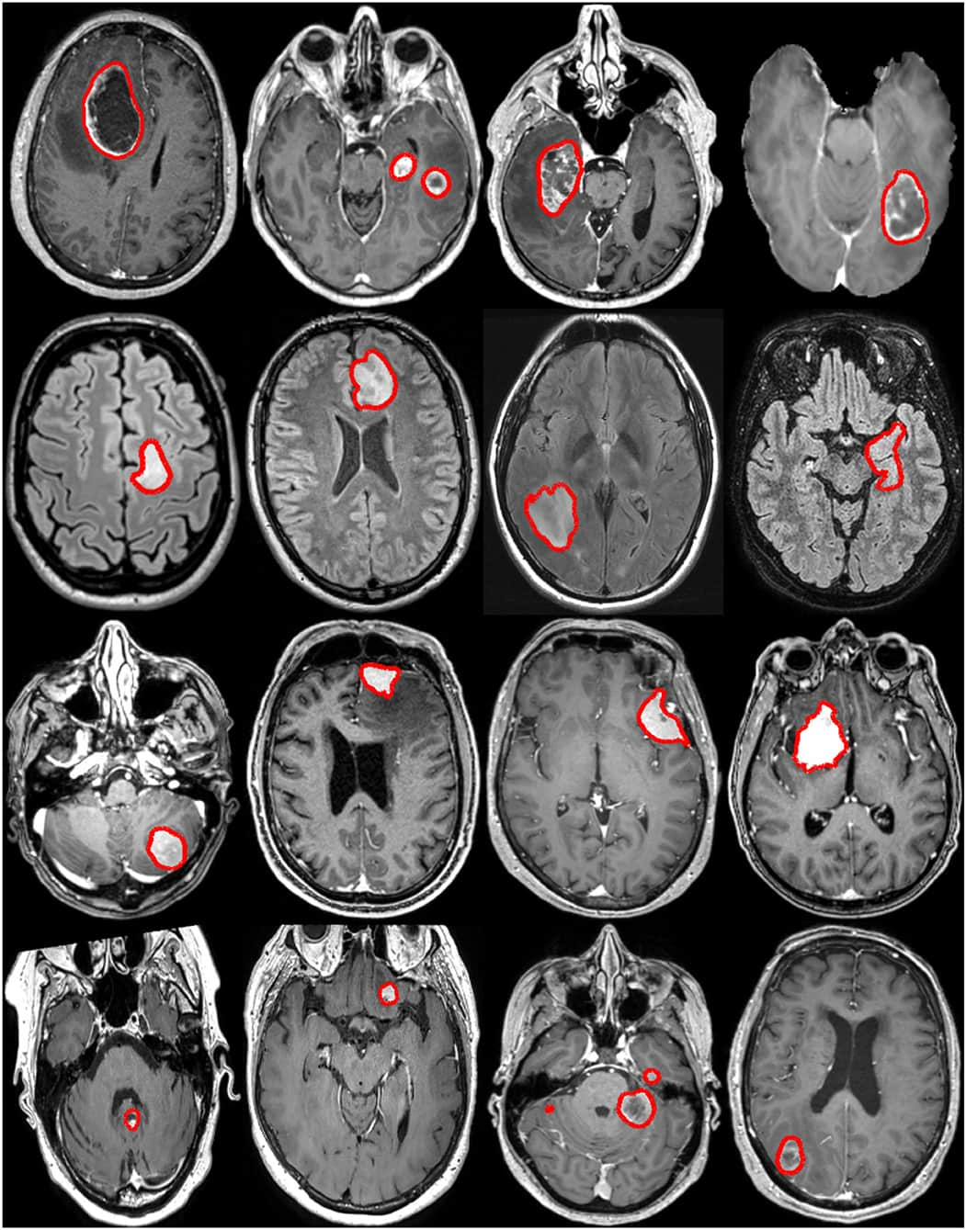

Data Collection
Overview :
To create our Brain Cancer MRI ( Magnetic Resonance Imaging ) & dataset, we collected a some of datasets, based on three different types of brain tumors (glioma, meningioma, pituitary) and another dataset does not contain any disease to train our model.
Datasets :
https://www.kaggle.com/datasets/obulisainaren/multi-cancer
https://www.kaggle.com/datasets/masoudnickparvar/brain-tumor-mri-dataset
https://www.kaggle.com/datasets/ahmedhamada0/brain-tumor-detection
https://www.kaggle.com/datasets/pradeep2665/brain-mri

Slide 14
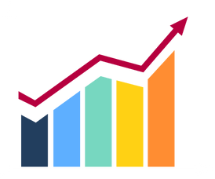
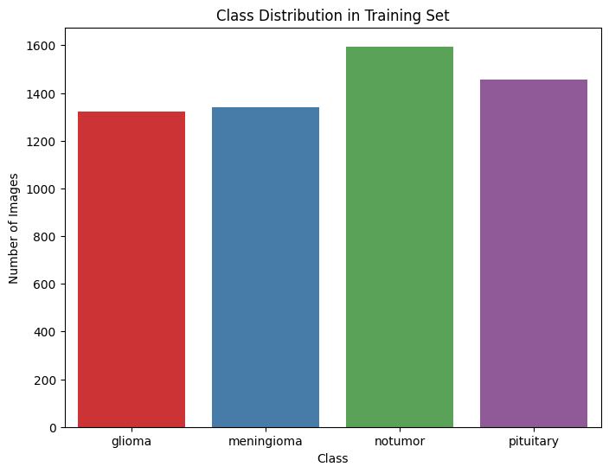
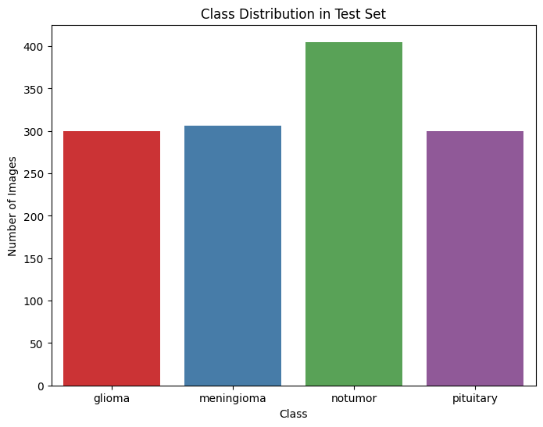
Data Collection Statistics

Slide 15
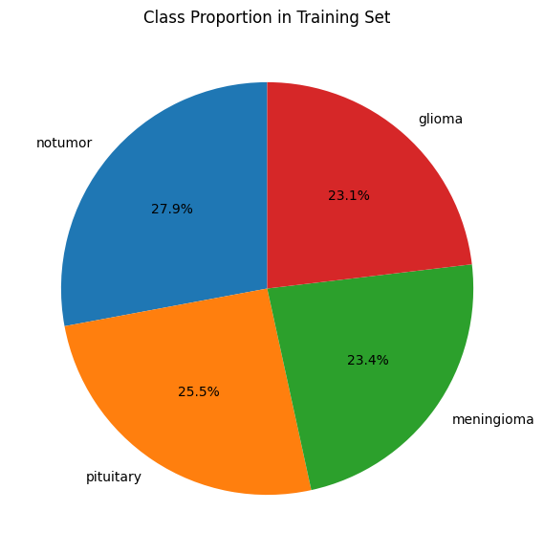
Data Collection Statistics

Slide 16
2873
1608
284
293
266
128
232
708
Data Collection
Overview :
To create our Ocular disease recognition dataset, we collected a some of datasets, based on six different types of Ocular disease recognition (Diabetic, Glaucoma, Cataract, AMD, Hypertensive, Myopia ) and another dataset does not contain any disease to train our model.
Primary Datasets :
https://www.kaggle.com/datasets/andrewmvd/ocular-disease-recognition-odir5k
Secondary Datasets :
https://www.kaggle.com/datasets/gauravduttakiit/macular-degeneration-detection
https://www.kaggle.com/datasets/dhruvrsastry/macular-degeneration
https://www.kaggle.com/datasets/rakhshandamujib/armd-curated-dataset-2023
And 30 more

Slide 17
Ocular Dataset
2873
1608
284
293
266
128
232
708
6,392 photos
ODIR

Slide 18
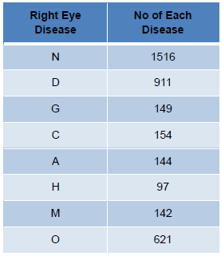
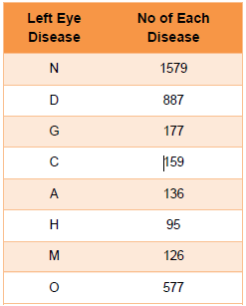
Data Collection Statistics

Slide 19
Data Augmentation
apply augmentation on ODIR so that the class of less number will be equal to the class the has most number
The augmentation actions will be :
1. rotation_range=20
2. brightness_range=[0.7,1.3]
3. horizontal_flip=True
4. zoom_range=[0.95, 1.05]
5. fill_mode='nearest'

Slide 20
Data Gathering
Steps
1. ODIR contain two execl sheets full_df.cv and data.xlxs concatenate this two files
2. the column of the label in the data look like wrong so apply label extraction into new seven column
3. gathering datasets from more than 33 resource and make excel sheet for dataset that hasn’t excel sheet
4. concatenate all the excel sheets into one and pay attention to the schema
5. ODIR has 6392 image and after adding the collected data it become 64,648 images
6. do augmentation on the ODIR only and leave the the collected dataset as it is
**Since there is augmented images done by authors in some of datasets that are collected
So when apply augmentation on the all of the dataset
There will be some noisy picture will appear**
7. And add augmented dataset on it to The dataset become 82,323 images

Slide 21

Image Preprocessing
Save Preprocessed Image
Splitting Dataset
Image
Reading
&
Cleaning
Image Resizing
4
5
Image Collection & Exploration
3
2
1

Slide 22


Model Training
Pre
processing
CNN
Layers
Feature Extraction
Dense Layers
Training
& Optimization
Forward, Back Propagation
Until finish Training & Optimization

Slide 23
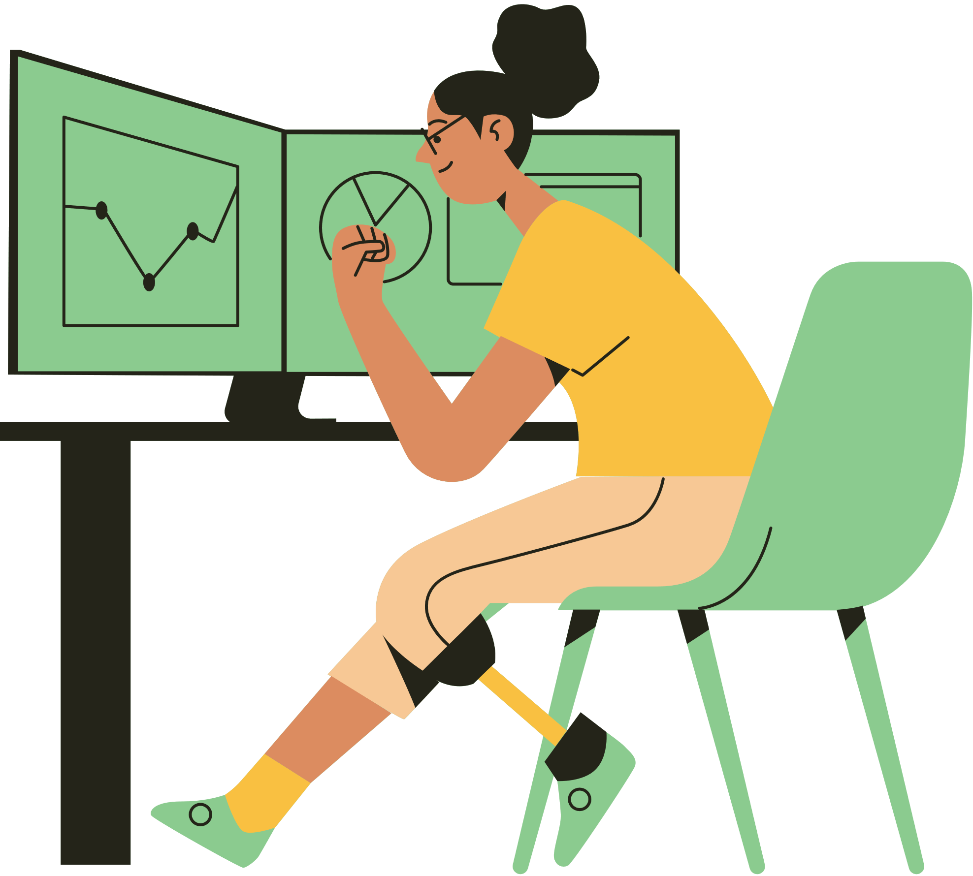
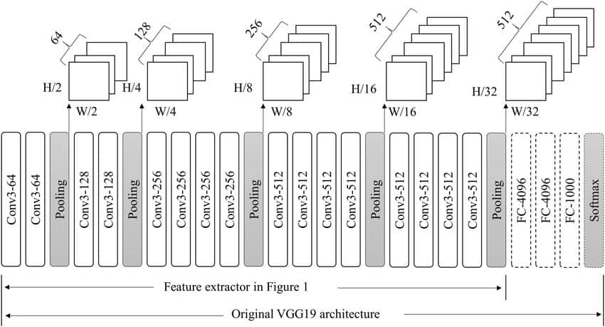
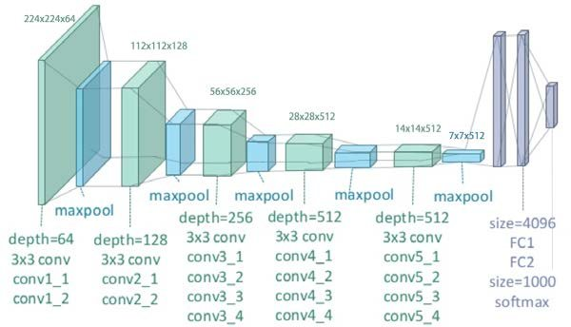
Proposed Pretrained Model
VGG19
Why?
Strong Performance
Simple Architecture
Best Accuracy

Slide 24

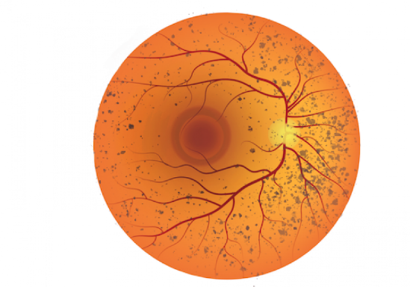
Approach
Normal vs Diabetic
Multi Binary Classification
Normal vs Glaucoma
Diabetic : 0.67
Glaucoma : 0.32
Cataract :0.21
AMD : 0.87 Hypertensive : 0.06
Myopia : 0.02
Other : 0.97
Upload Image
Normal vs Cataract
Aggregator
Normal vs AMD
Normal vs Hypertensive
Normal vs Other
Normal vs Myopia

Slide 25
Hyper-parameters
-Activation function = RELU
-Optimizer = Adam
-Loss Function = binary cross entropy
-Epochs = 100
-Batch size = 32
-Image size = 224
-Channels= 3 (RGB)
We have changed the hyperparameters in the model many times to get
the best results.

Slide 26
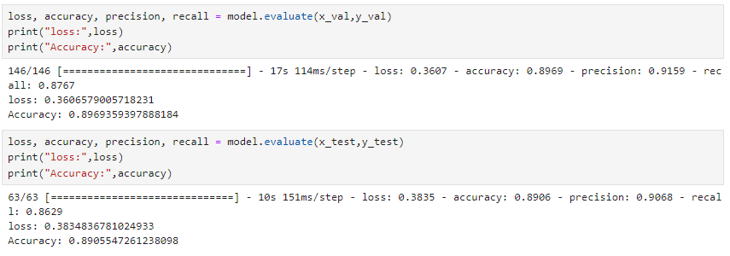
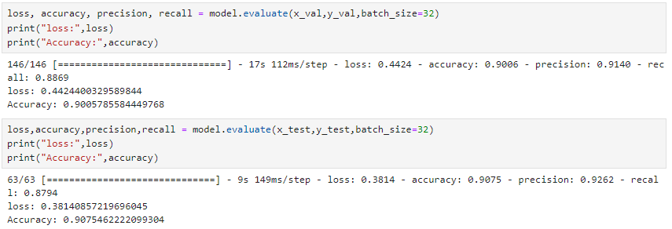
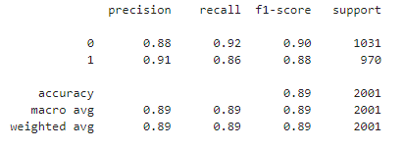
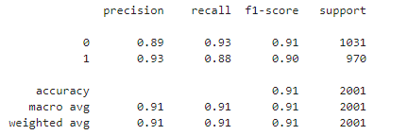
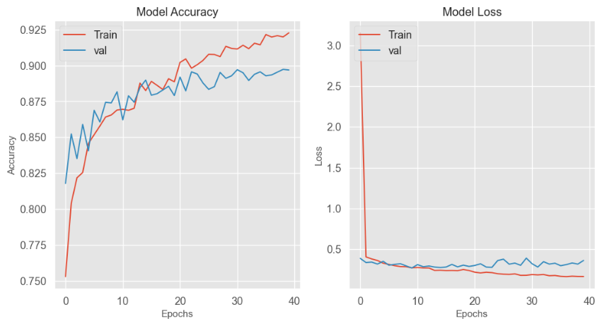
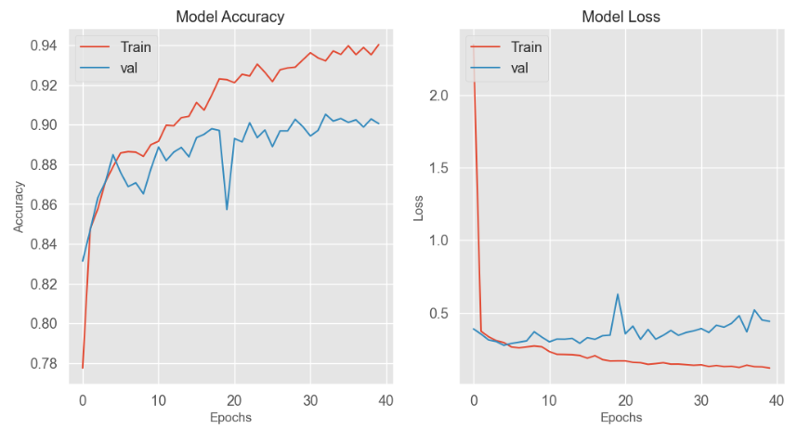
Training Analysis
Binary Classification
Augmented ODIR only and collected Dataset
Results
Binary Classification
Normal vs Diabetic
Normal vs Glaucoma

Slide 27
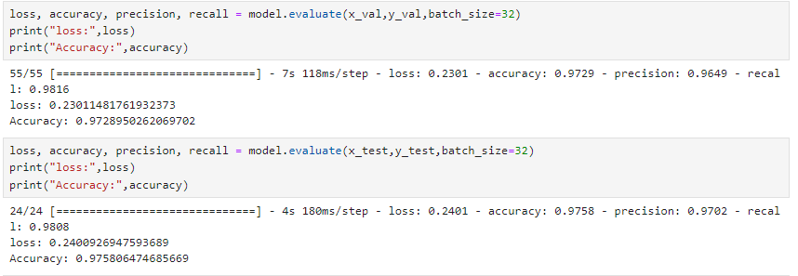
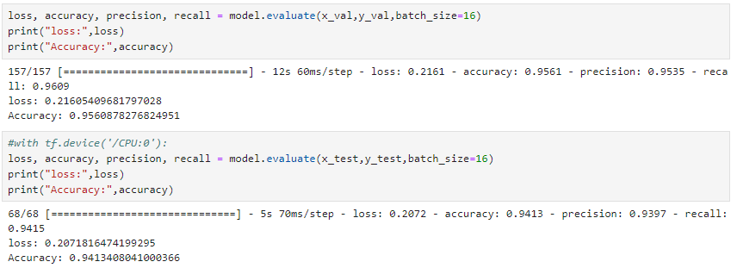




Training Analysis
Binary Classification
Augmented ODIR only and collected Dataset
Results
Normal vs Cataract
Normal vs AMD

Slide 28
Training Analysis
Binary Classification
Augmented ODIR only and collected Dataset
Results
Normal vs Cataract
Normal vs AMD

Slide 29






Training Analysis
Binary Classification
Augmented ODIR only and collected Dataset
Results
Normal vs Hypertensive
Normal vs Myopia

Slide 30



Training Analysis
Binary Classification
Augmented ODIR only and collected Dataset
Results
Paper Link: https://www.ncbi.nlm.nih.gov/pmc/articles/PMC9071974/
Normal vs other
N | D | G | C | A | H | M | O
Paper | 0.868 | 0.909 | 0.940 | 0.866 | 0.889 | 0.981 | 0.861
model | 0.6023 | 0.8077 | 0.9431 | 0.7143 | 0.7402 | 0.93.13 | 0.3184
model | 0.7968 | 0.9462 | 0.9826 | 0.9351 | 0.9655 | 0.9951 | 0.80
model | 0.8909 | 0.8688 | 0.9871 | 0.9512 | 0.9759 | 0.8753 | 0.7931
model | 0.8906 | 0.9075 | 0.9758 | 0.9413 | 0.9593 | 0.9335 | 0.8511

Slide 31


After the last approach
Use all the 7 binary model weights to predict the image labels

Slide 32








Model Evaluation
Confusion Matrix
Binary Classification
Augmented ODIR only and collected Dataset

Slide 33

Proposed Pretrained Model
Xception
Why?
Fewer weights
Less training time
Higher Accuracy

Slide 34


Training Analysis
Multi Classification
MRI Dataset
Accuracy Graph
Results
Loss Graph
Training Accuracy = 98.70 %
Training Loss = 4.52 %
Validation Accuracy = 98.30 %
Validation Loss = 5.77 %

Slide 35

Model Evaluation
Confusion Matrix

Slide 36




APIs
We create two APIs :
The first one : We use Streamlit framework in python to create our API to get the response from deep learning model.
The Second : we create API for Microsoft Azure to add prebuilt services.
IMAGES

Slide 37



Microsoft Azure

Slide 38


Streamlit
Why do we use Web applications?
Ease of Use for Data Science & ML Applications: Streamlit is designed specifically for creating web apps to showcase data science and machine learning models.
No front-end skills needed: You can build interactive apps using only Python.
Fast Prototyping & Development: With minimal code, you can quickly prototype apps.
Streamlit allows you to display data, graphs, and machine learning models with just a few lines of Python code.
Interactivity with Widgets: Built-in widgets like sliders, buttons, and text inputs allow for creating dynamic applications without JavaScript.
Real-time interaction with Python objects for exploring data or model parameters.
Strong Community & Ecosystem: Streamlit has an active community and is rapidly growing.
It integrates well with Python libraries like Pandas, Matplotlib, Plotly, and TensorFlow, making it easy to showcase visualizations and machine learning models.
Deployment & Sharing: Streamlit apps can be deployed quickly via Streamlit Cloud or platforms like AWS.
Share your interactive web applications with a link, allowing users to interact with your data and models in real-time.

Slide 39
APIs
We create three APIs :
The first one : We use Flask framework in python to create our API to get the response from deep learning model.
The Second : we create API for SQLite to add or delete any user he has want.
The Third : we create API for Microsoft Azure to add prebuilt services.
IMAGES

Slide 40







Backend System
& Tools
SQLite
Flask
Python
Azure
VS Code
Colab
jupyter

Slide 41



SQLite & Database
1. Authentication
2. Signup
3. Login
4. Verification
Doctor

Slide 42
Web Framework (Flask)
Why do we use Web applications?
Cross-Platform Development : Flask supports the development of lightweight web applications that can run on different platforms.
HTML/CSS/JavaScript offer responsive and interactive user experiences.
Efficient for both desktop and mobile users.
2. Flexibility & Simplicity : Flask is a micro-framework that provides developers with simplicity and control.
HTML structures the web pages, CSS styles them, and JavaScript adds interactivity.
3. Strong Community and Ecosystem : Flask has a large and active community, offering many tutorials, extensions, and third-party libraries.
Integrates seamlessly with front-end technologies (HTML, CSS, JS).
4. Reusable Components: HTML templates in Flask allow code reuse, reducing development time.
CSS frameworks like Bootstrap provide pre-built components, and JavaScript libraries like jQuery simplify scripting.
.
5. Hot Reload & Fast Development: Flask's built-in development server supports hot reloading, allowing developers to see changes without restarting the server.
Combine with JavaScript for dynamic page content and CSS for instant design adjustments.

Slide 43









Web Application (flask)
5. Upload Image
6. View & success
7. Output
Ocular
1. Home Page
2. Signup
3. Login
4. Dashboard
Brain
5. Upload Image
6. View & success
7. Output

Slide 44
Web(Features)
Some of Features
Registration & Login & Logout
Chatting & Searching
Manage Users (Add & Delete)
Predict Brain Cancer MRI
Predict Ocular disease

Slide 45




Future Work
Make the scaling of application is larger to handle many different of users.
Make an application version for web to make it easier for users to use our web app.
Add Video call for users and doctors.
Support different languages to gain more audience from all over the world.
Activate Facebook authentication.
Add dark mode theme to our application.
Train another model on object detection techniques to detect the Infected cells.
Train another model on NLP techniques for predicting brain prescription texts.

Slide 46




Future Work
Future Work
1
4
Improve the quality
2
3
Build an advanced ML model for identifying & diagnosing
Link the application with sensors
Build Smart Chatbot with AI

Slide 47
ANY QUESTIONS?

Slide 48









THANK YOU !

